Slide 1


Slide 2
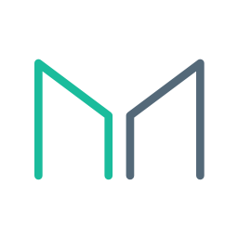
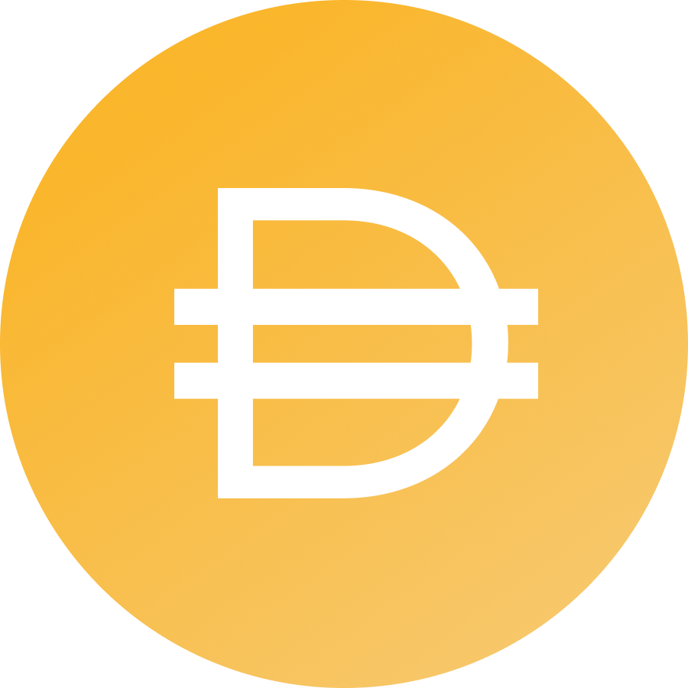
What is MakerDAO?

Slide 3
Open Platform For Stability

Slide 4
1 DAI = $1

Slide 5
Why Do We Need a Stablecoin?

Slide 6
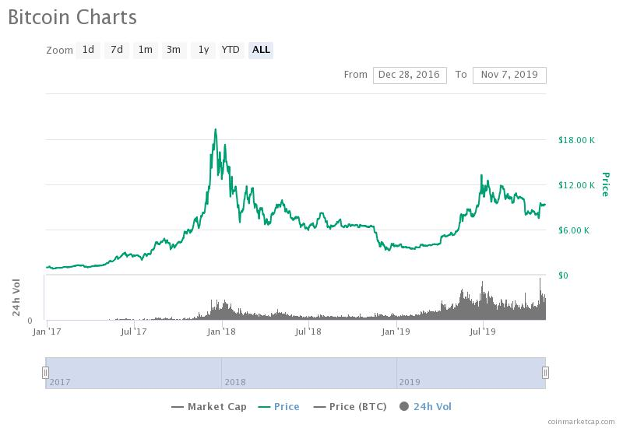
Problem: Instability
1
The ultimate gauge of capital is denominated in the Global Currency, which is USD.
Is Bitcoin stable relative to the Global Currency?
Notes:
Describe graph

Slide 7
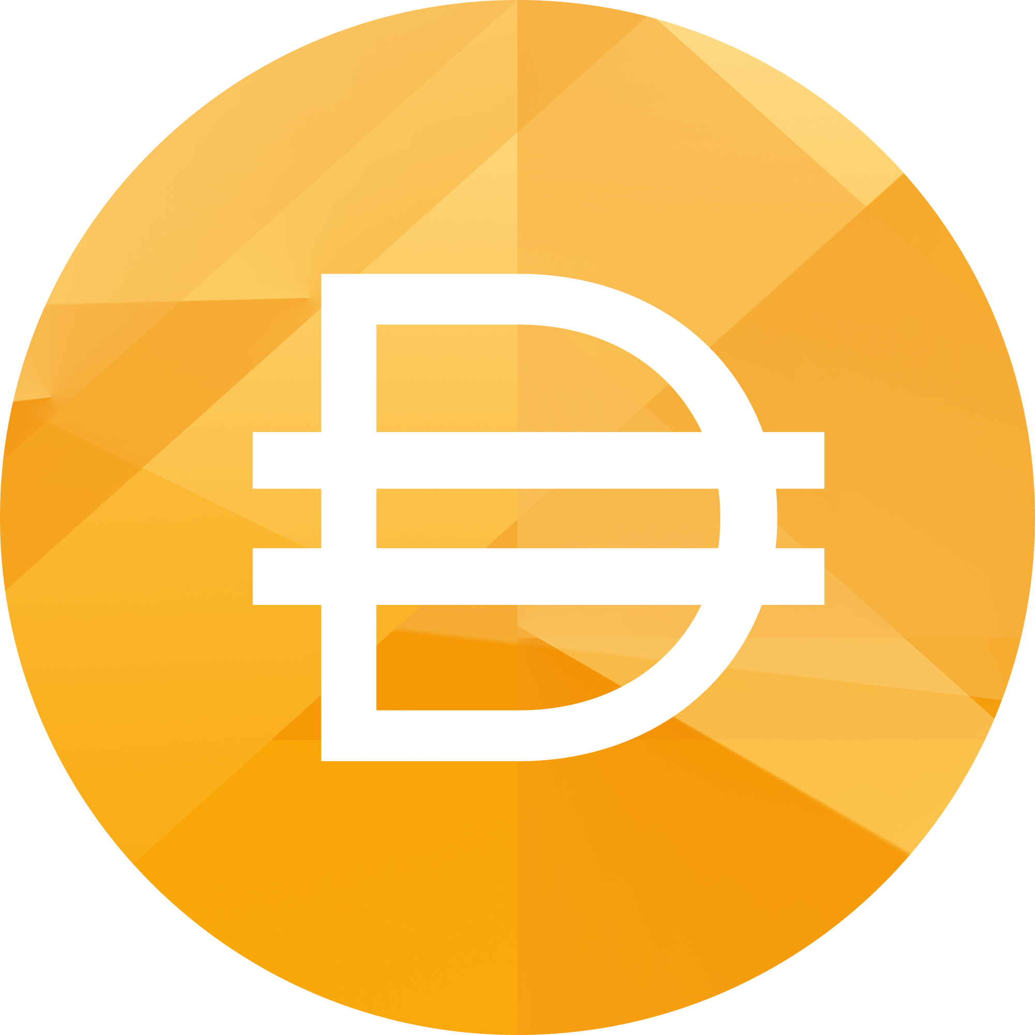
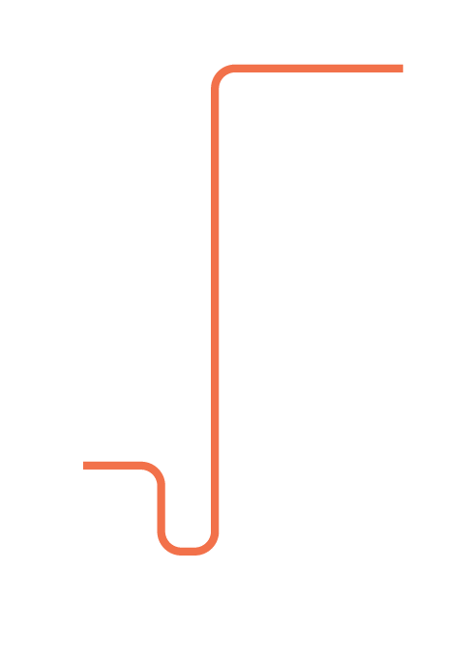
Maker’s Flagship Product
Dai - Stablecoin
Dai soft-pegged to USD
Basic user
Fully backed by collateral
1
$

Slide 8
Dai - Economics
How does it keep its peg?
Demand curve can shift due to market conditions, confidence of Dai holders, etc
Supply curve is shifted through a permissionless credit factory on Ethereum
Any actor can vary the supply of Dai through a Maker Vault
The system was built so that these actors are incentivized to shift the supply curve to ensure that the price is close as possible to $1
Demand
Supply
$1
Quantity
2

Slide 9
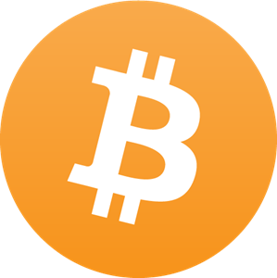
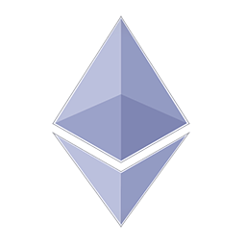
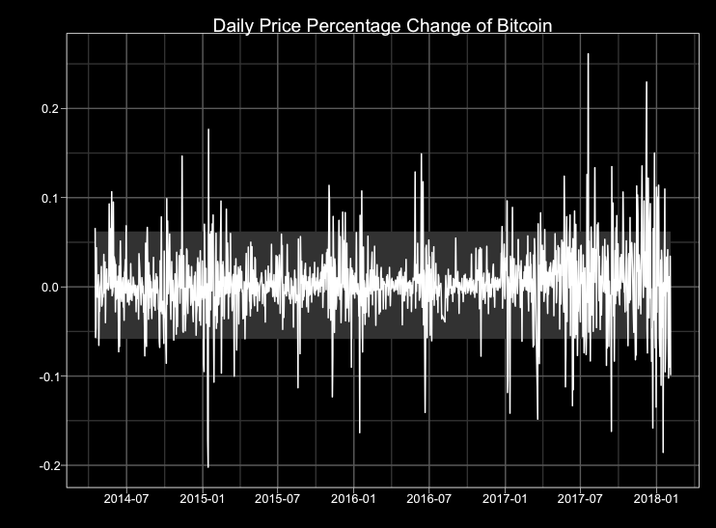
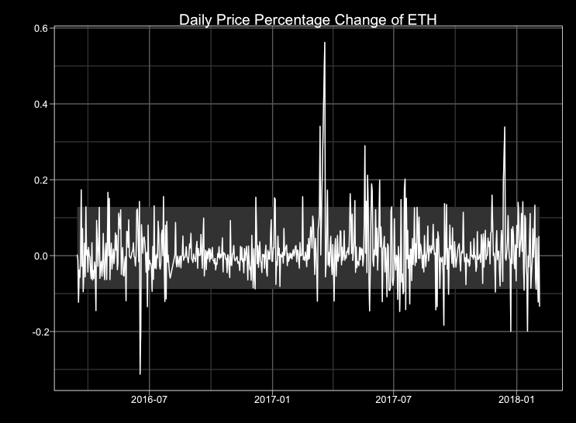
Bitcoin and Ethereum?

Slide 10
A Stable Medium of Exchange

Slide 11
How Does Dai Work?

Slide 12
Imagine the gold standard but with any asset

Slide 13


Two Types of Users
Stability Seekers (basic)
vs
Risk Seekers (advanced)

Slide 14
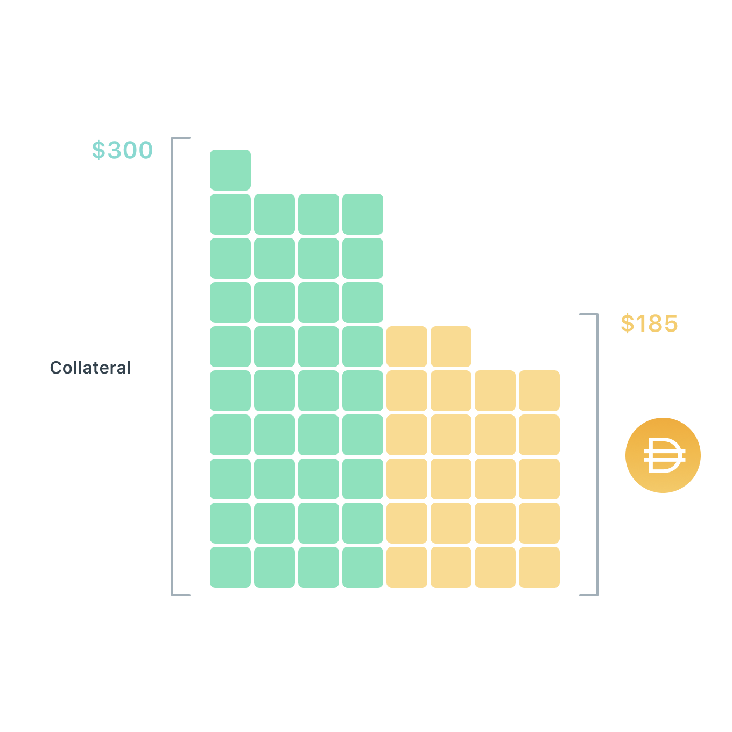
Vault
Borrow Dai through locking up collateral
Repay Dai + fee to retrieve collateral

Slide 15
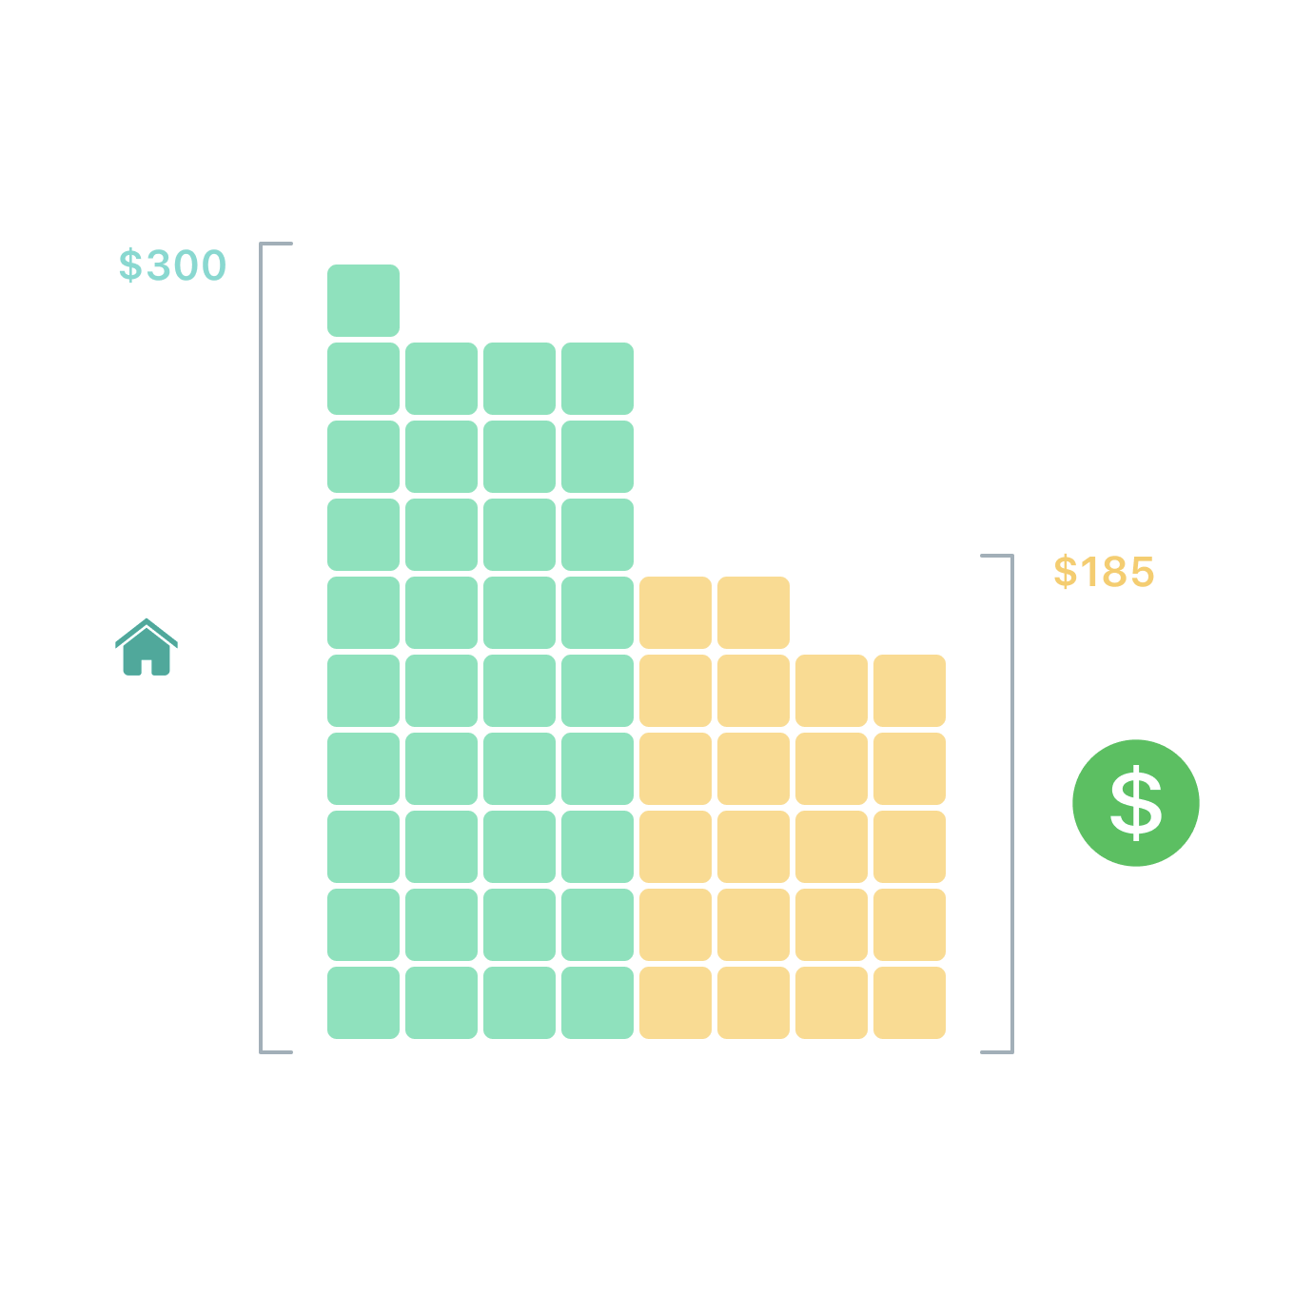
Analogous To A Mortgage
Borrow money with a mortgage from the bank
Repay debt + interest to “retrieve” the house

Slide 16
Open Decentralized Credit System

Slide 17

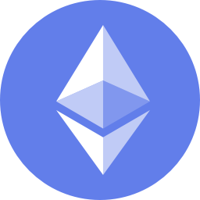
Decentralized Margin Trading
Vault
ETH
DAI

Slide 18
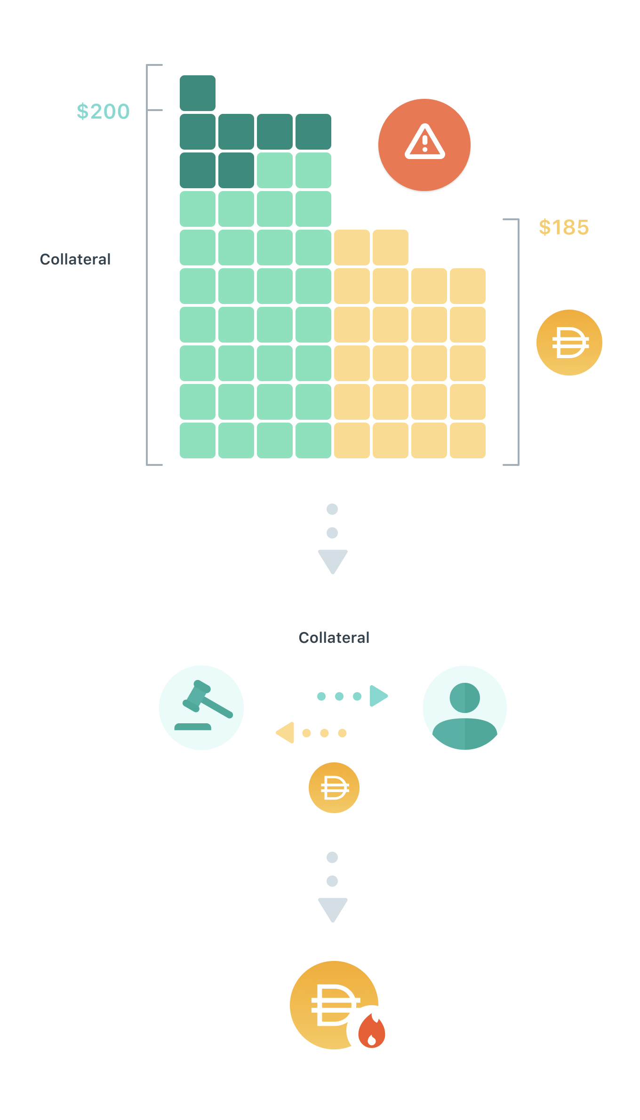
Liquidations
A Vault is automatically liquidated if the collateral value (in USD) falls too low
Part of the collateral is auctioned off by the Protocol to cover the outstanding debt + penalty fee
Dai is then burned by the Protocol to decrease the supply
Vault owner receives the leftover collateral

Slide 19
How Does Dai Remain Stable?

Slide 20

Ultimate Goal
Balance demand for creating and holding Dai

Slide 21
Stability Mechanisms
Supply Side
Demand Side
Diversification

Slide 22

Supply Side
Incentivize supply expansion & contraction

Slide 23
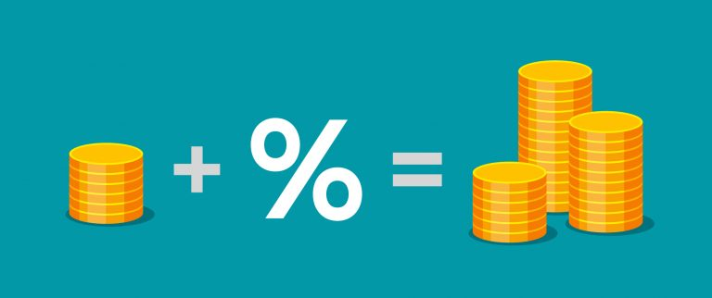
Demand Side
Dai Savings Rate

Slide 24
Dai Savings Rate
Regulates demand for holding Dai
A demand-side lever to complement the supply-side lever
Strengthens the peg
Increases utility of Dai
Enables new business models

Slide 25

Diversification
Diversified portfolio of non-correlated assets
Preferably highly liquid

Slide 26

Redeemability
Emergency Shutdown

Slide 27
Who Makes These Decisions?

Slide 28
Decentralized Governance

Slide 29

MKR
Manages risk
Finances bailouts
“Highest risk, highest reward”

Slide 30
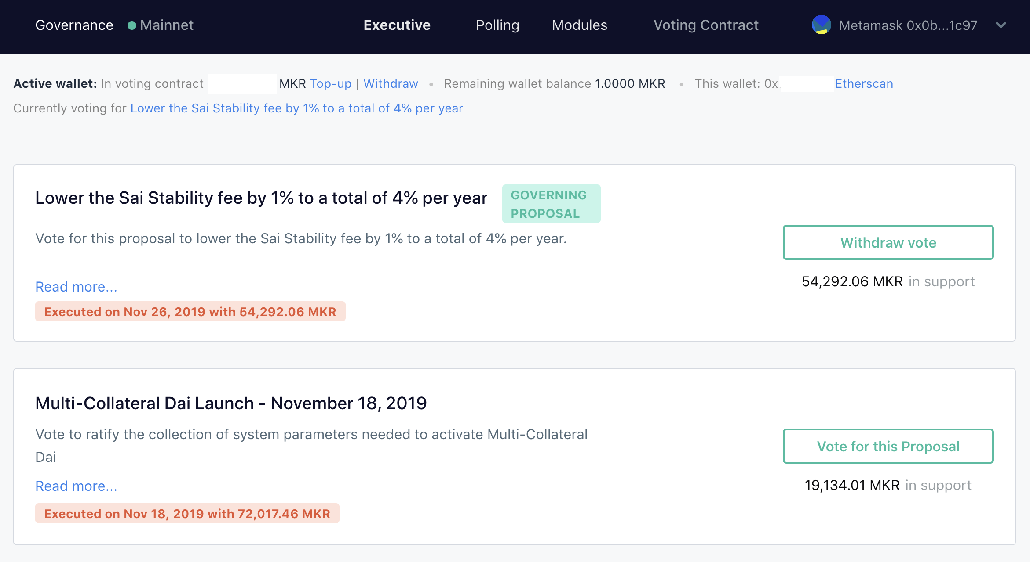

Slide 31
Where Are We Now?

Slide 32
Dai Is Live!

Slide 33
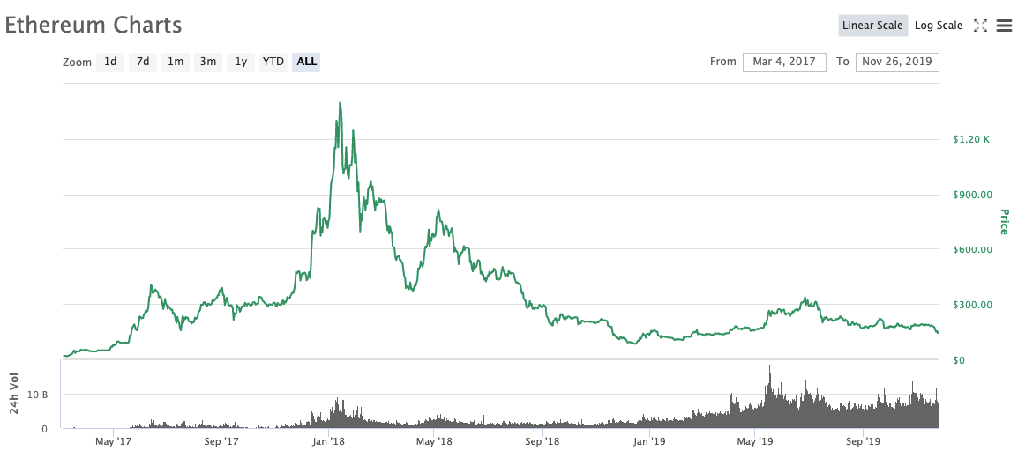

Slide 34
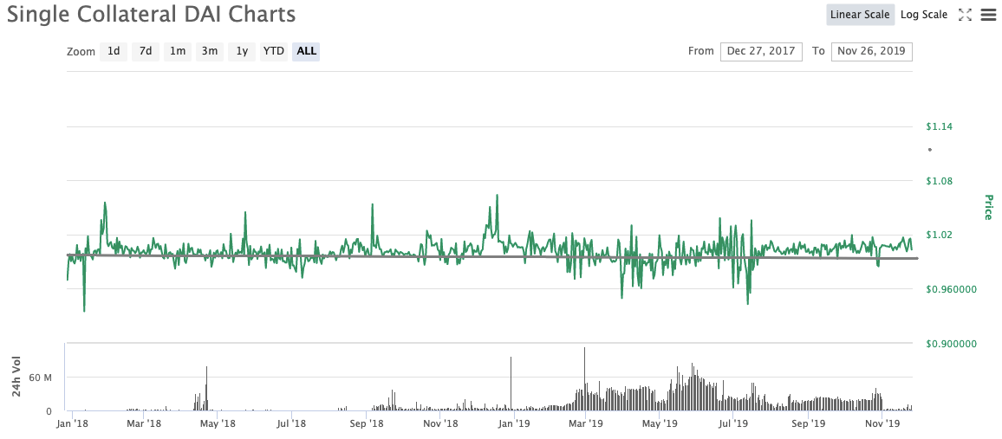

Slide 35
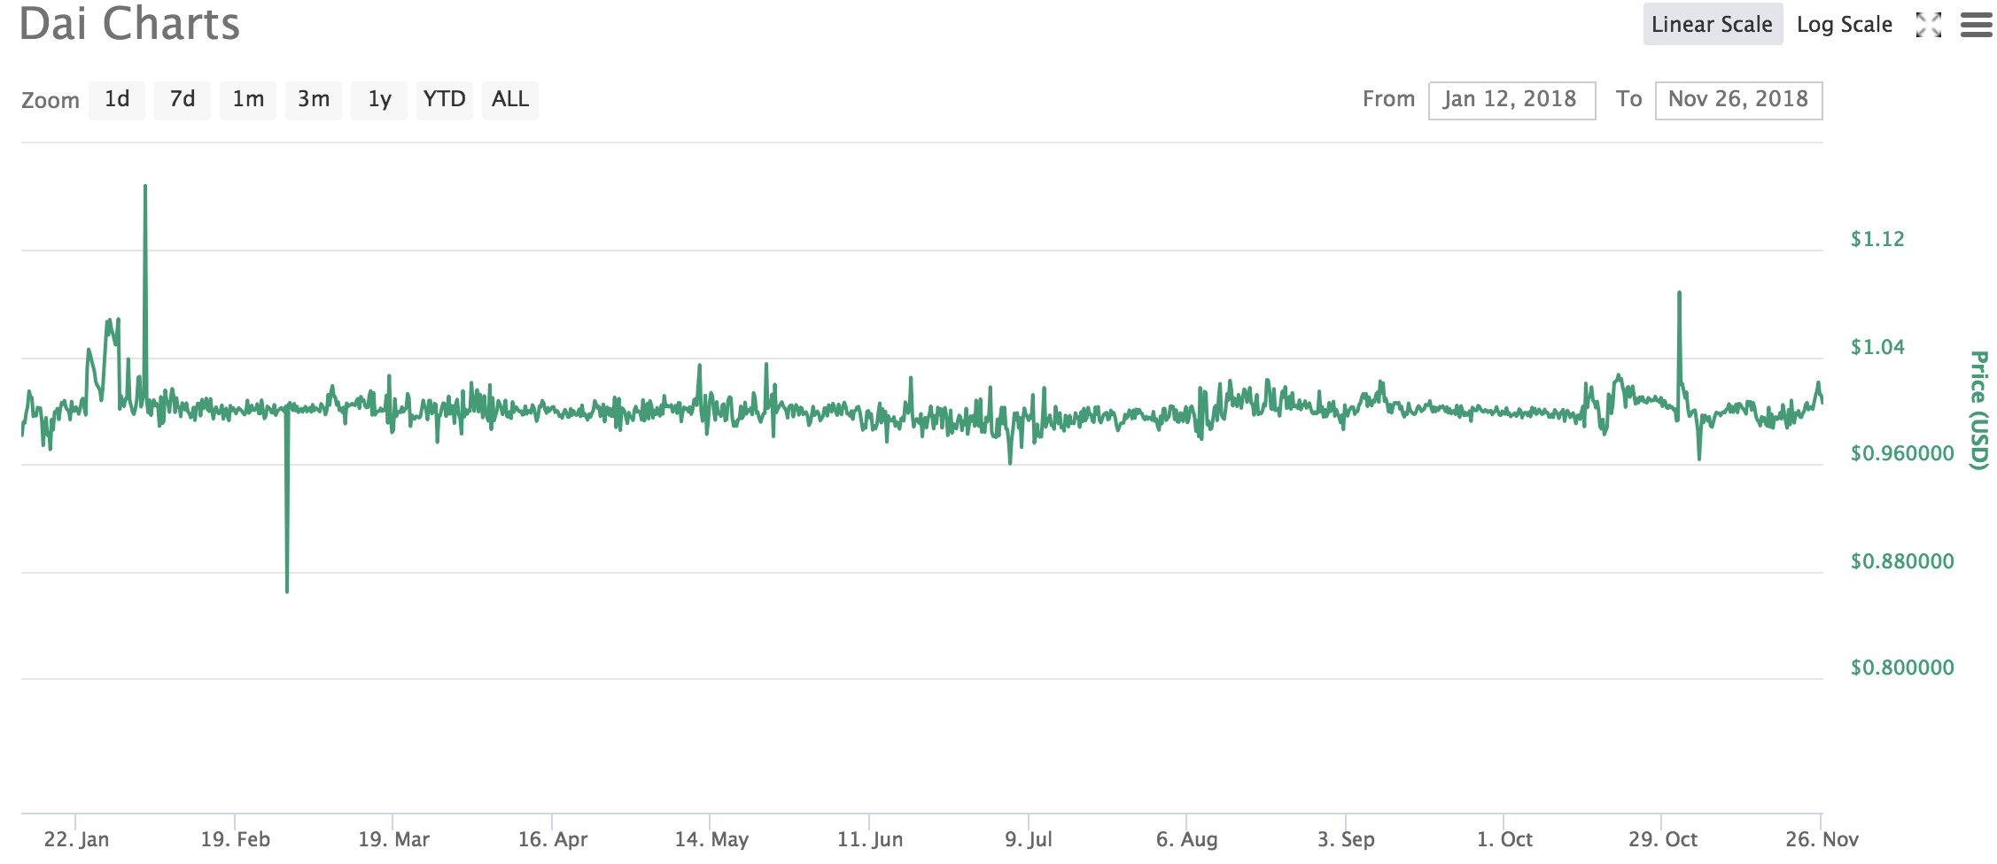

Slide 36
Remittances
International remittances exceeded $600B in 2018
$440B sent to developing countries in 2018
Remittances to developing countries more than triple international aid
Global average cost is 8%
Up to 20% in Sub-Saharan African and Pacific Islands

Slide 37
Invoice Factoring
Invoices are effectively a way for large corporations to get interest free loans from suppliers
Businesses are highly reliant on cashflow
Allow businesses to access equity in their invoices
Global invoice factoring exceeded $3 Trillion in 2017
Partnering with Tradeshift to tokenize invoices to use as collateral for Dai.

Slide 38
Thank you.
makerdao.com

Slide 39
Appendix

Slide 40
Sai vs Dai
3
Single Collateral DAI
Single collateral type backing Dai
Collateral is ETH
Less diversified
Liquidations occur at a fixed discount to the current collateral price
MKR used to pay stability fee
Decentralized governance through MKR voting rights
Multi Collateral DAI
Multi. collateral types backing Dai
Collateral can be any approved asset
More diversified and stable
Liquidations are handled using Auctions
Dai used to pay stability fee
Decentralized governance through MKR voting rights

Slide 41





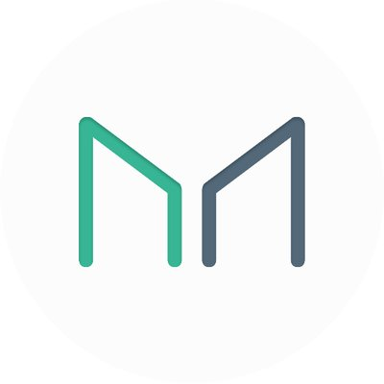




System Interaction Diagram
2
Developers
Oracles
Keepers
Maintainers
MKR Holders
Dai Holders
Maker Protocol
Risk Teams
Vault Owners
Governors
Users
Notes:
Describe graph

Slide 42
System Interaction Actors
2
User
Governor
Dai Holders
Basic - No additional knowledge to own Dai
Stability Seekers; Consumer; Businesses
Vault Owners
Intermediate - Some knowledge
Risk Seekers; Speculators; Borrowers
MKR Holders
Advanced - Extensive knowledge
Monitor, partake, and vote on upgrades/changes in the Maker Protocol
Risk Teams
Advanced - Extensive knowledge
Collect/compile relevant data and develop risk models, assessed by MKR Holders
Notes:
start at box, give an example or two

Slide 43
System Interaction Actors
2
Maintainer
Developers
Basic - No additional knowledge to own Dai
Stability Seekers; Consumer; Businesses
Oracles
Intermediate - Some knowledge
Risk Seekers; Speculators; Borrowers
Keepers
Intermediate - Some knowledge
Risk Seekers; Speculators; Borrowers
Anyone with the required knowledge can freely participate in any role
Any one person (or service) can have multiple roles
Notes:
start at box, give an example or two

Slide 44
System Lines of Defense
2
At any point, the system must have more value in collateral than value of Dai supply.
The following mechanisms help maintain system solvency:
1. Supply and Demand
Supply and demand of Vaults (and thus Dai) is influenced by the Stability Fees, Dai Savings Rate, and Debt Ceiling adjustments.
2. Liquidation
Any time the collateral value of a Vault gets closer to its debt, it becomes “risky-er”. The system liquidates Vaults that get too risky.
Notes:
First Line of defense doesn’t really help maintain system solvency, since the system collateralization is not a function of dai demand
Liquidation -> collateral auction
If collateral auctions don’t cover enough debt within the auction lifetime, then the system takes responsibility of this deficit in the form of bad debt. If bad debt accrues too fast, then MKR burning begins

Slide 45
System Lines of Defense
2
3. MKR Minting/Burning
If MKR holders govern the Maker Protocol successfully, the Protocol will accrue Surplus Dai as Dai holders pay Stability Fees. On the other hand, if liquidations are inadequate, then the Protocol will accrue Bad Debt. Once this Surplus Dai / Bad Debt amount hits a threshold, as voted by MKR holders, then the Protocol will discharge Surplus Dai / Bad Debt through the Flapper / Flopper smart contract by buying and burning / minting and selling MKR, respectively.
4. Emergency Shutdown
This is a process that is used as a last resort in cases of extreme market irrationality, attacks, or coordinated upgrades. Emergency Shutdown gracefully settles the Maker Platform while ensuring that all users, both Dai holders and Vault users, receive the net value of assets they are entitled to.
Notes:
First Line of defense doesn’t really help maintain system solvency, since the system collateralization is not a function of dai demand
Liquidation -> collateral auction
If collateral auctions don’t cover enough debt within the auction lifetime, then the system takes responsibility of this deficit in the form of bad debt. If bad debt accrues too fast, then MKR burning begins

